Slide 1
CAS Machine Learning Working Party
Context and Key Issues in Ratemaking

Slide 2
Presenters
Marco De Virgilis - Marco is a Senior Actuarial Data Scientist at Allstate in Chicago. He is currently working on developing ML solutions to actuarial problems in both ratemaking and reserving.
Navarun Jain - Navarun is an analyst at Lux Actuaries & Consultants based in Dubai. As a Vice-Chair of the Working Party, Navarun leads the workstream on practical use cases/applications of machine learning in the actuarial field.
Nathaniel Loughin - Nate is a Director with KPMG’s P&C Actuarial Practice, specializing in predictive analytics, large account pricing, and E&S Reserving and Operations.

Slide 3
Get the Code
Slides, code and data used in this presentation are available at:
https://github.com/mlwp3/CAMAR

Slide 4
Introduction
Notes:
Group 2 will present an introduction to what is machine learning, what kinds of things has it been used for in the insurance sector, what kinds of models exist for different purposes, where we’ve seen a lot of research and where there hasn’t been as much as we’d expect, etc.

Slide 5
What is Machine Learning?
Catch-all term for a lot of concepts
Usually involves a flexible algorithm that is iteratively adjusted based on optimizing some function of the data
E.g., take all the data, apply some transformations, and calculate how far you are from the answer you wanted, make adjustments, repeat
Usually no closed-form solution to optimization problem, which necessitates iterative solutions
Examples:
Computer vision
E-mail spam filtering
Netflix recommendations

Slide 6
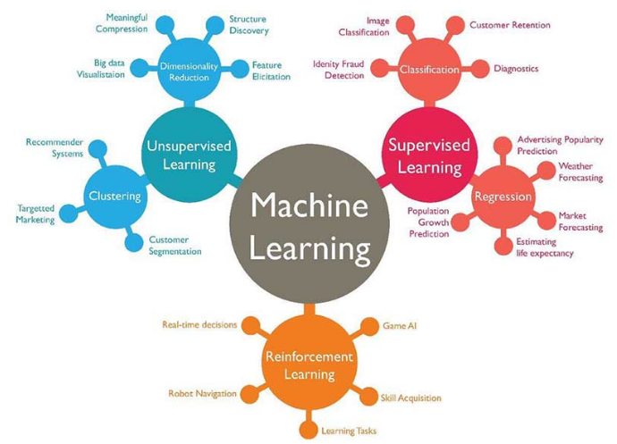
What is Machine Learning?

Slide 7
Machine Learning Pros
Good for open-ended problems (like computer vision) where it would be hard to manually engineer a model
Good for finding “hidden” relationships in data or selecting optimal subsets of predictors
“On-line” learning and predicting possible
Can fit highly non-linear functions that may be challenging for traditional approaches like GLMs
Open-source software makes it easy!

Slide 8
Machine Learning Cons
Not as transparent as statistical methods
Not all statistical tools are available for evaluating model performance
Can over-fit to data and create highly non-linear functions where you don’t expect
Computational cost - many of these models take a long time and a lot of computing power!

Slide 9
Why Should We Care About Machine Learning?
It’s cool, and it will make you cool
It’s going to be everywhere
It can get much better results than more traditional models
It can help explain results and identify patterns you might otherwise miss

Slide 10
Potential Applications to Ratemaking
ML algorithms can enhance conventional models
ML can enhance other insurance company functions
ML can provide additional monitoring tools
ML can enhance customer segmentation
ML can expand profitability
...
Notes:
May be a more familiar context for stakeholders (e.g., regulators) to understand model results
Makes available all common model fit diagnostics, some of which may not be available in a pure machine learning context where a model may be deterministic

Slide 11
Practical Applications
ML in action
Notes:
Group 3 will present the models, leaving out some of the key “explanatory” graphs (probably) so we can come back to them after Group 1 talks about communication issues

Slide 12
The Data
freMPTL2 from R’s CASdatasets package.
The data contains motor third-party liability policies from a French Insurer. Claim numbers and claim amounts, alongside a selection of risk features are available for analysis.
Notes:
Some potential questions
How did we account for exposure?
How were each of the models tuned?
How did the models account for imbalance?

Slide 13
Variables
DRIVER
Age
Region
Density
VEHICLE
Age
Brand
Power
Fuel Type
POLICY
Exposure
Bonus/Malus
Claim Count
Claim Amount

Slide 14
The Models

Slide 15
Models Considered
GLMs - The Classic Generalized Linear Model
GBM - An approach that uses many weak predictors to generate robust estimates
NN - Layers of “neurons” that “learn” to reproduce desired output based on input
MARS - An automatic GLM that only uses linear splines
RF - A large number of big trees (vs GBMs which use small trees)

Slide 16
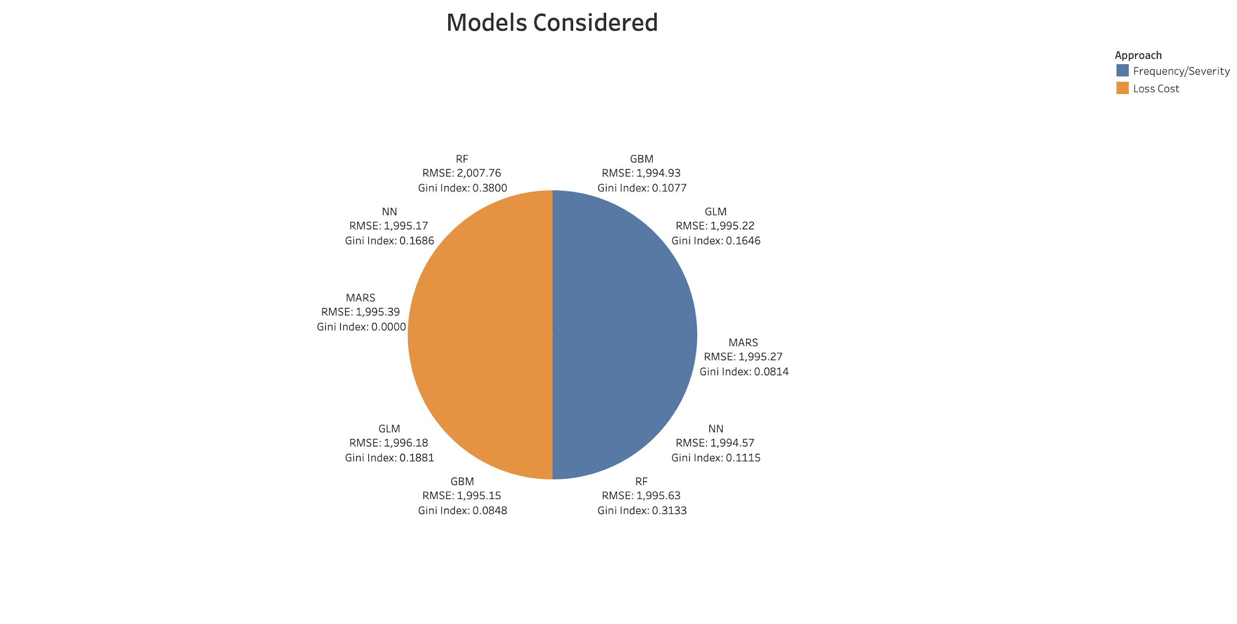

Slide 17
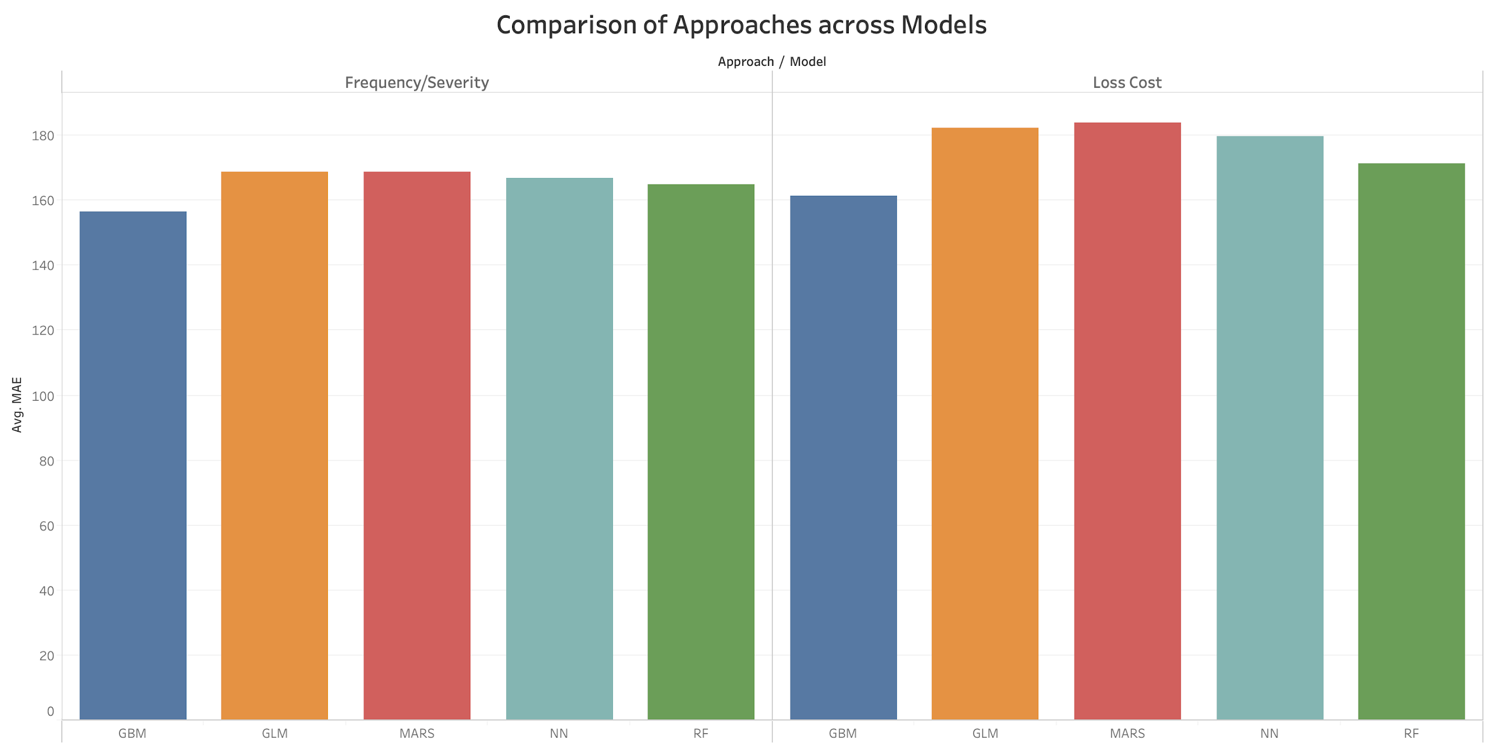

Slide 18
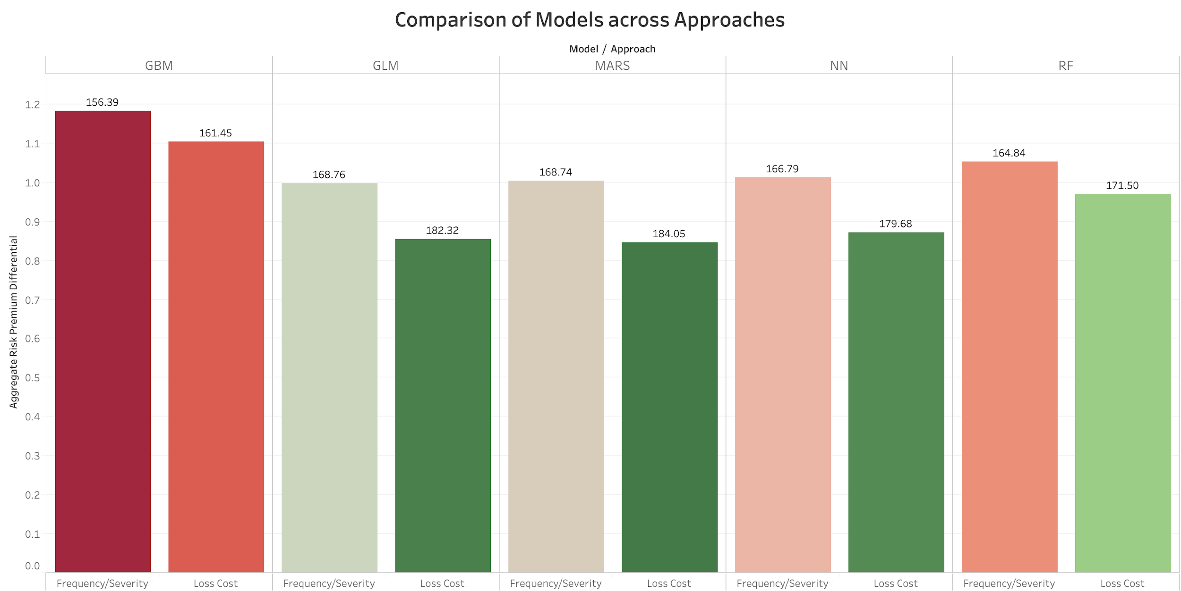

Slide 19
Communications Issues in ML
Towards Explainable AI (XAI)
Notes:
Group 1 to discuss key issues with communication of models and possible solutions. It sounds to me from our call on 12/12 that this will have a more regulatory focus, but I think it makes sense to broaden it to the extent possible to be more about “stakeholders.” In addition, we will want to touch on issues like ASOPs

Slide 20
Occam’s Razor
The simplest explanation is usually the best
“...accuracy and simplicity (interpretability) are in conflict. For instance, linear regression gives a fairly interpretable picture of the x, y relation. But its accuracy is usually less than that of the less interpretable neural nets.”
L. Breiman
Notes:
We are leaving the realm of simple and intuitive solutions. We need to be able to explain the results of our models to a diverse audience. We need explainable AI (XAI).

Slide 21
Start by Considering the Audience
Technical Stakeholders
Other Actuaries
Non-Technical Stakeholders
External
Regulators
Auditors
Internal
Profit Center Executives
Sales & Marketing
Agents & Insureds
Notes:
Sophisticated stakeholders can be swayed by model diagnostics
Unsophisticated stakeholders require explanations in simpler terms

Slide 22
ASOP 41 - Actuarial Communications
“...another actuary qualified in the same practice area could make an objective appraisal of the reasonableness...”
Notes:
ASOP 41 assumes that the recipient has some knowledge of ML. This is the most sophisticated audience that ML users will face.

Slide 23
ASOP 41 - ML Issues
The model includes the algorithm, data, hyperparameters, fitting methods
ML is often “ad hoc” - many models are unique for their application
ML algorithms and their underlying data are often proprietary
Notes:
How can you assess the reasonableness without knowing all of these?
Models won’t take on a predictable form.
How do you communicate adequately without giving away your IP or revealing sensitive information?

Slide 24
Regulators May Lack ML Capabilities
NAIC survey from 2017 indicates that:
Not all states have personnel qualified to review GLMs
Plurality of respondents note that filing complexity and/or lack of resources or expertise impeded their department’s ability to review GLMs
Not all states have an effective mechanism to protect confidentiality of models or other information submitted with a rate filing
Notes:
Given that not all states can effectively review GLMs, we have to assume that machine learning is probably a similar or worse situation.
One question arising from this slide may be: why not stop stringent rate regulation and let the market find the right prices? To which I (Daniel) would reply that, anecdotally, a TON of rate filings I have reviewed produce rates that are (unintentionally) unfairly discriminatory, and the modelers failed to identify those issues. And that’s with GLMs - not highly non-linear black-box algorithms! The problem stems from easy-to-use off-the-shelf modeling products that make it possible to model without knowing much about what you’re doing. I would imagine that ML will compound this problem because (a) it produces pretty good results right out of the box, and (b) it’s extra-difficult to interrogate what the model is doing!

Slide 25
Regulatory Issues
Need to demonstrate that rates are not inadequate, excessive, or unfairly discriminatory
“Unfairly discriminatory” may be a challenge unless we can explain why a model produces a particular outcome.
Need to file a rating plan
Does a black box meet the legal definition of a “filed rate”?
Is it necessary to convert the ML model to relativities for implementation?
Notes:
Does an applicant or insured have a “right to an explanation” in the case of an adverse underwriting decision? If we can’t explain why the model returned a particular outcome then we become exposed to claims of unfair discrimination.
Relativities require binning

Slide 26
Internal Communications
Is the price change consistent with the corporate strategy and messaging?
How do we explain the change to our management?
Will our agents be able explain the change to their insureds?
What do you say to insured whose premium changes because the model changed?
Who will be impacted the most?
Notes:
These questions tend to align with the various communication strategies shown later, e.g. Variable Importance Plots and Partial Dependence Plots address the why/major drivers question.
Agents understand relativities.

Slide 27
Bridging the Communication Gap
Notes:
Group 3 responds to Group 1’s “communication issues” by presenting possible analyses that address some of those ideas, like variable importance, partial dependence plots, LIME, etc.

Slide 28
Basic Idea
ML can be a black box - let there be light!
Notes:
Group 3 responds to Group 1’s “communication issues” by presenting possible analyses that address some of those ideas, like variable importance, partial dependence plots, LIME, etc.

Slide 29
MODEL INTERPRETATION
GLOBAL
Trying to understand the predictions on an overall level – In general, why does a model behave the way it does?
LOCAL
Trying to understand predictions for specific records – For a given record, what led the model to predict what it did?

Slide 30
Global Interpretation Strategies
TECHNICAL
Variable Importance
Interaction Effect Analysis
Feature Effect Analysis
Model Lift
Gini Index/Gini Plot
NON-TECHNICAL
Partial Dependence Plots

Slide 31
Partial Dependence Plots

Slide 32
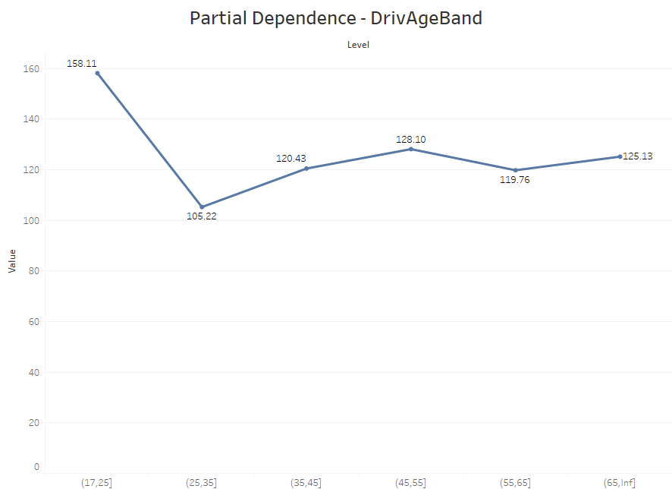

Slide 33
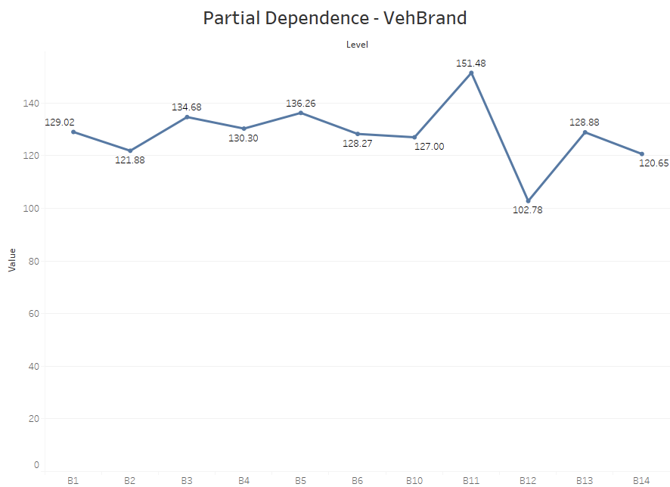

Slide 34
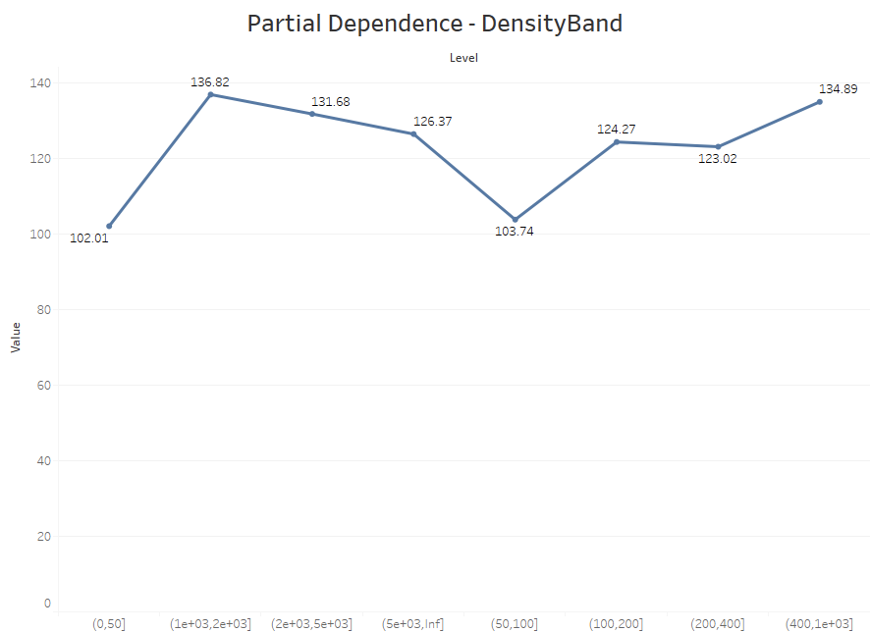

Slide 35
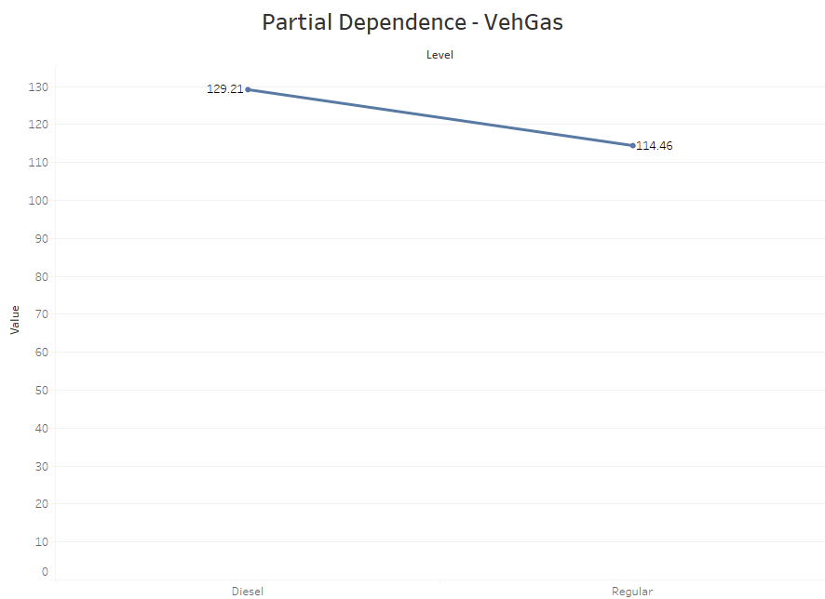

Slide 36
Variable Importance
Based on Permutation-based Loss Dropout
Each rating variable is shuffled and model recomputed
Degree of difference in RMSE w.r.t. original model indicates variable importance

Slide 37
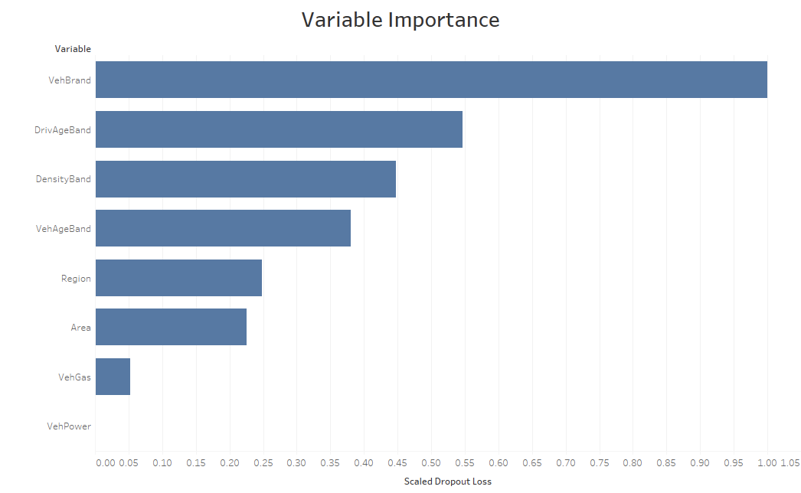

Slide 38
Interaction Effects
Based on Partial Dependence (PD) - studies how model predictions depend on individual predictors
Uses the Friedman H-Statistic
Measures the degree of impact the joint PD of 2 variables has on the overall PD of the combination, intuitively,
PD(X, Y) = PD(X) + PD(Y) + PD(X & Y)

Slide 39
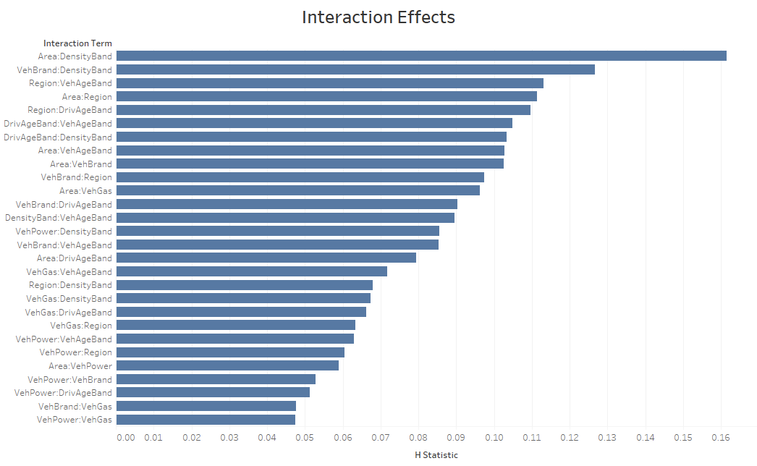

Slide 40
Non-Technical Communication Strategies
For the rating plan, the model must be converted to relativities.
Tools such as Lime may be needed to generate the relativities.
ML can replace “judgement” in some rating plan components. For example:
Clustering used in a classification analysis
AI used to generate a brush-fire hazard map
Rating examples help stakeholders can get a “feel” for what the model does.
Notes:
Many components in a pricing analysis rely on the analysts judgement in some way. Replacing the analysts judgement with an algorithm reduces the subjectivity in the pricing process.

Slide 41
References
Henckaerts, Roel and Antonio, Katrien and Clijsters, Maxime and Roel, Verbelen, A Data Driven Binning Strategy for the Construction of Insurance Tariff Classes (May 12, 2017). Available at SSRN: https://ssrn.com/abstract=3052174 or http://dx.doi.org/10.2139/ssrn.3052174
Beuerlein, B. et al. Big Data and the Role of the Actuary. American Academy of Actuaries Big Data Task Force, June 2018
Kuo, Kevin. DeepTriangle: A Deep Learning Approach to Loss Reserving. Risks 7.3 (2019): 97.
Dai, Jie. Enhancing the Generalized Linear Modeling Approach with Machine Learning Technique. E-Forum, Casualty Actuarial Society, Spring 2018, vol. 2.
Lally, Nathan & Hartman, Brian, 2018. Estimating loss reserves using hierarchical Bayesian Gaussian process regression with input warping, Insurance: Mathematics and Economics, Elsevier, vol. 82(C), pages 124-140.
Jamal, S., et al. Machine Learning & Traditional Methods Synergy in Non-Life Reserving. Report of the ASTIN Working Party of the International Actuarial Association, 2018
Wuthrich, Mario V., Machine Learning in Individual Claims Reserving (November 11, 2016). Swiss Finance Institute Research Paper No. 16-67. Available at SSRN: https://ssrn.com/abstract=2867897 or http://dx.doi.org/10.2139/ssrn.2867897
Spedicato, Giorgio and Dutang, Christophe and Petrini, Leonardo, Machine Learning Methods to Perform Price Optimization: A Comparison with Standard Generalized Linear Models. Variance, Casualty Actuarial Society, 2018, 12 (1), pp. 69-90. hal-01942038
Gabrielli, Andrea and Richman, Ronald and Wuthrich, Mario V., Neural Network Embedding of the Over-Dispersed Poisson Reserving Model (November 21, 2018). Available at SSRN: https://ssrn.com/abstract=3288454 or http://dx.doi.org/10.2139/ssrn.3288454

Slide 42
References, Continued
Wuthrich, Mario V., Neural Networks Applied to Chain-Ladder Reserving (July 6, 2018). Available at SSRN: https://ssrn.com/abstract=2966126 or http://dx.doi.org/10.2139/ssrn.2966126
Guelman L., Guillén M., Pérez-Marín A.M. (2012) Random Forests for Uplift Modeling: An Insurance Customer Retention Case. In: Engemann K.J., Gil-Lafuente A.M., Merigó J.M. (eds) Modeling and Simulation in Engineering, Economics and Management. MS 2012. Lecture Notes in Business Information Processing, vol 115. Springer, Berlin, Heidelberg
Yeo, A. C., Smith, K. A., Willis, R. J., & Brooks, M. (2001). Modelling the effect of premium changes on motor insurance customer retention rates using neural networks. Lecture Notes in Computer Science, 2074, 390 - 399. https://doi.org/10.1007/3-540-45718-6_43
Salcedo‐Sanz, S., DePrado‐Cumplido, M., Segovia‐Vargas, M.J., Pérez‐Cruz, F. and Bousoño‐Calzón, C. (2004), Feature selection methods involving support vector machines for prediction of insolvency in non‐life insurance companies. Intelligent Systems in Accounting, Finance and Management, 12: 261-281. doi:10.1002/isaf.255
Ye Tian, Wei Yang, Gene Lai, Menghan Zhao. Predicting non-life insurer's insolvency using non-kernel fuzzy quadratic surface support vector machines. Journal of Industrial & Management Optimization, 2019, 15 (2) : 985-999. doi: 10.3934/jimo.2018081
Kartasheva, Anastasia V. and Traskin, Mikhail, Insurers' Insolvency Prediction Using Random Forest Classification (December 7, 2013). Available at SSRN: https://ssrn.com/abstract=2364736
Andreas Behr & Jurij Weinblat (2017) Default Patterns in Seven EU Countries: A Random Forest Approach, International Journal of the Economics of Business, 24:2, 181-222, DOI: 10.1080/13571516.2016.1252532
Nilsson, M., & Sandberg, E. (2018). Application and Evaluation of Artificial Neural Networks in Solvency Capital Requirement Estimations for Insurance Products.

Slide 43
References, Continued
De Virgilis, M., Pierluigi C., Estimation of Individual Claim Liabilities. Casualty Actuarial Society, 2020. Available at https://www.casact.org/research/wp/papers/working-paper-Virgilis-Cerqueti-2020-01.pdf
ASTIN, Individual Claim Development with Machine Learning, 2017 Report. Available at http://www.actuaries.org/ASTIN/Documents/ASTIN_ICDML_WP_Report_final.pdf
Jain, N., Machine Learning: “Pricing” the Way Forward. Institute & Faculty of Actuaries (IFoA) TIGI 2019; available at
https://www.actuaries.org.uk/system/files/field/document/Pricing%20Plenary%202_Navarun%20Jain.pdf
Jain, N., Fraud Detection: How can Machine Learning Help? IFoA GIRO Conference 2019; available at
https://www.actuaries.org.uk/system/files/field/document/A5_Navarun%20Jain.pdf

Slide 44
ML Working Party Members
Daniel Lupton (Chair) Nathaniel Loughlin (Vice-Chair)
Navarun Jain (Vice Chair) Ralph Dweck
Peter Dyson James Ely
Harsh Karthik Hao Li
Liam McGrath Sharon Mott
Marjan Qazvini Seth Roby
Les Vernon Marco De Virgilis

